Slide 1
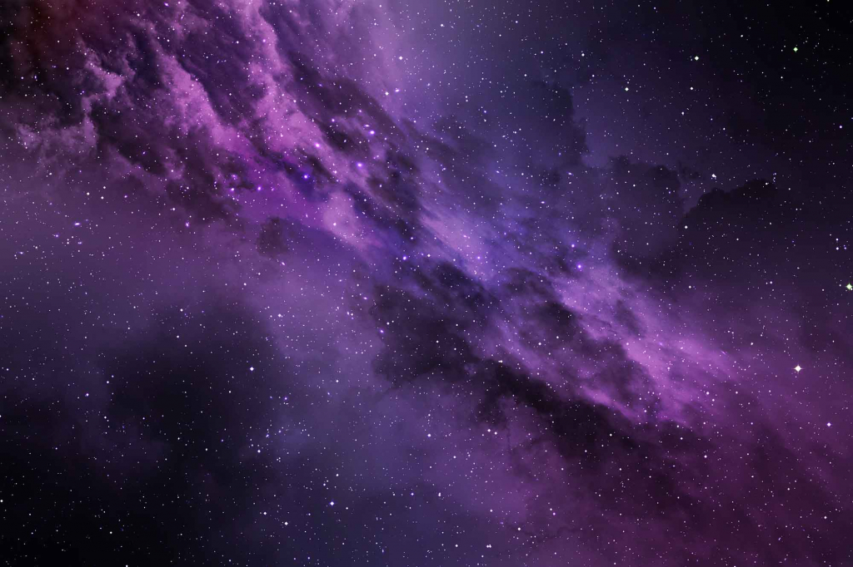
Super Space Maker
Totally Legit Balkans
Adriano Soldera
Andrei Popescu
Cristian Petru-Marza
Eric Tiganasu
“10 Free Space Background Images (JPG).” Unblast, 2021, https://unblast.com/10-free-space-background-images-jpg/. Accessed 14 Feb. 2025.

Slide 2
Task Breakdown

Slide 3
User Stories
As a student, I want to be able to customize my own planets so that I can visualize how solar systems work. (February 17 - April 13)
As a student, I want to easily see accurate planetary physics so that I can better understand the physics involved. (February 17 - April 13)
As a student, I want to have to option to save my simulations so that I can keep simulations that I like. (March 3 - April 13)
As a student, I want to be able to customize the look of my animation so that I can find it more visually aesthetic. (March 24 - April 13)
As a student, I want to be able to zoom in on planets so that I can see their respective data. (February 17 - March 2)
As a student, I want to be able to change variables so that I can simulate different outcomes. (March 3 - April 23)
As a student, I want to calculate various properties of different spatial bodies so I can better understand the physics involved. (March 3 - March 23)
As a student, I want to be able to change the time frame of the animation so that I can see the evolution of my system over long periods of time. (March 3 - March 23)

Slide 4
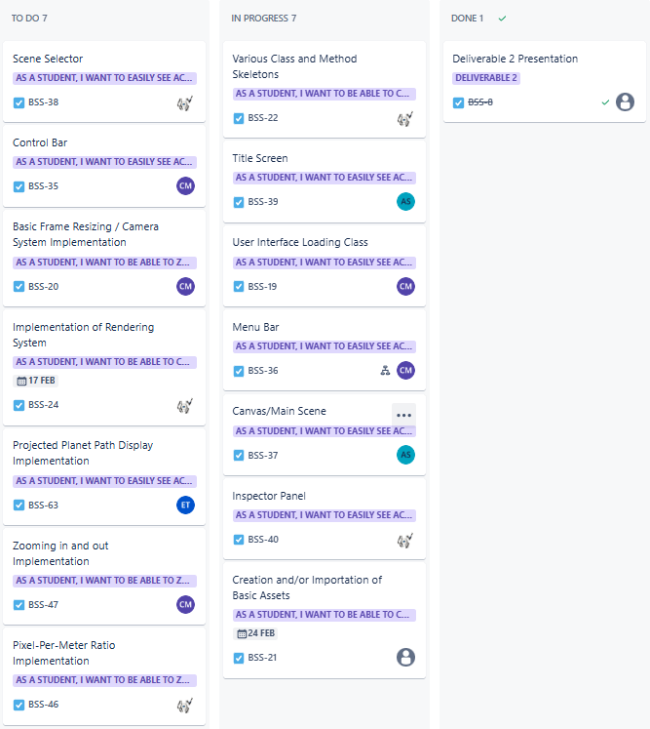
Jira Kanban
(First
Sprint)

Slide 5
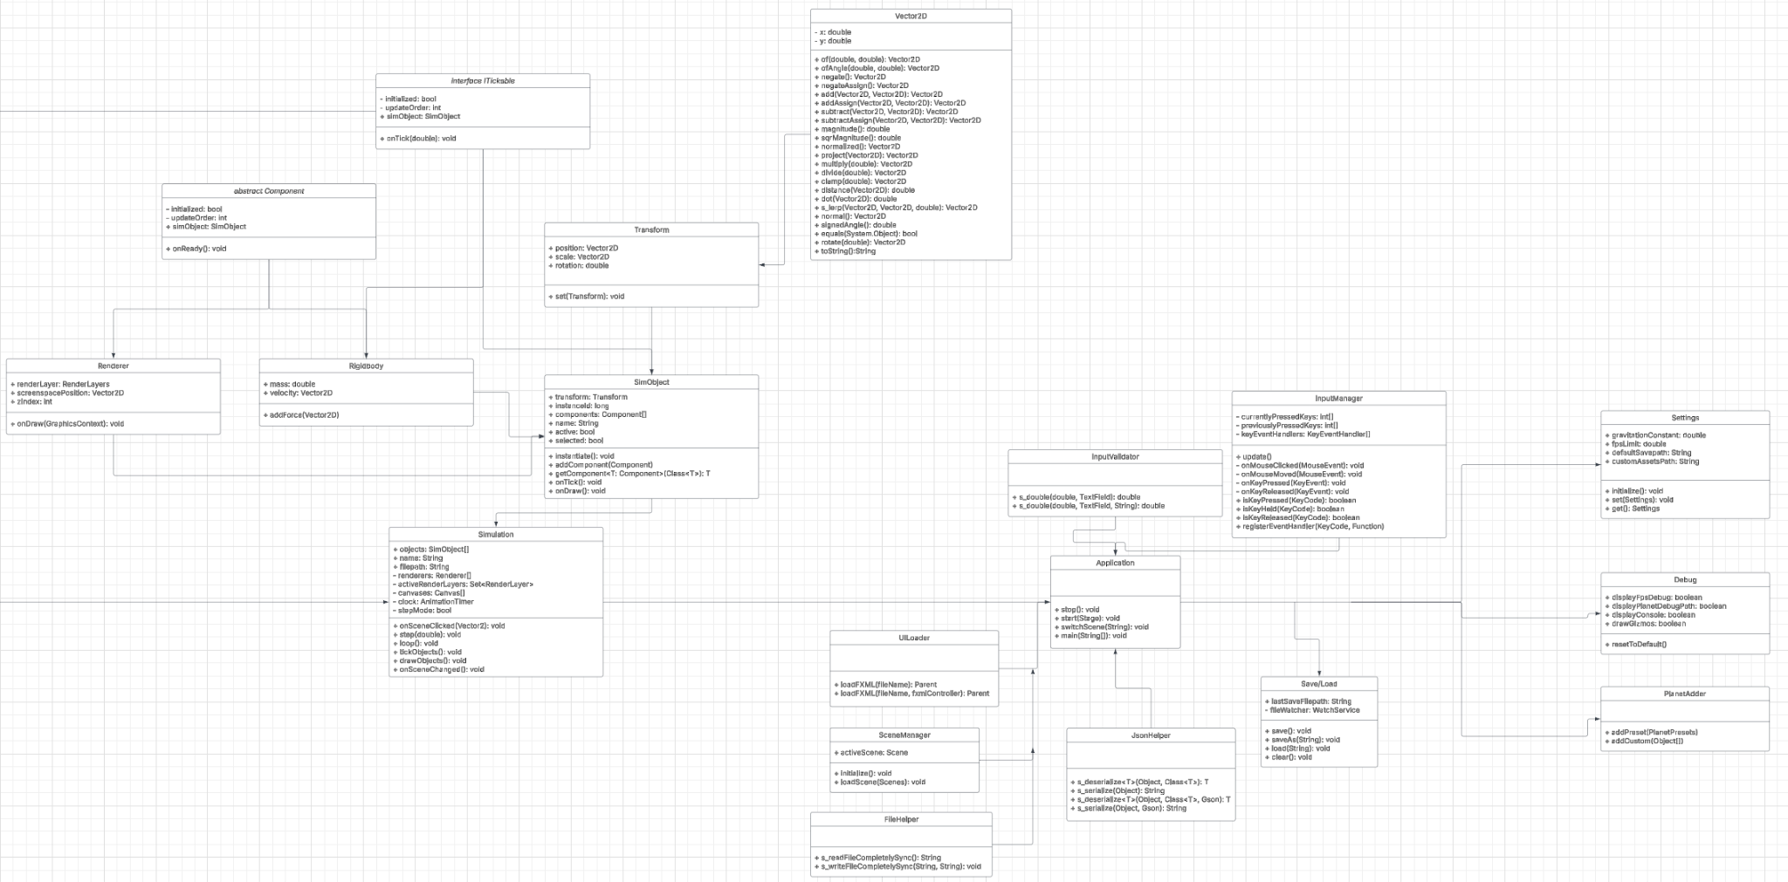
Class Diagram

Slide 6
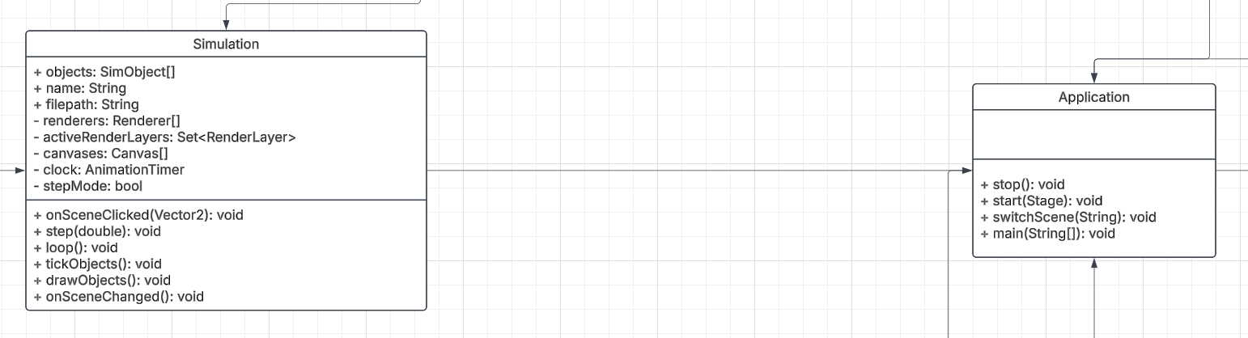
Overview

Slide 7
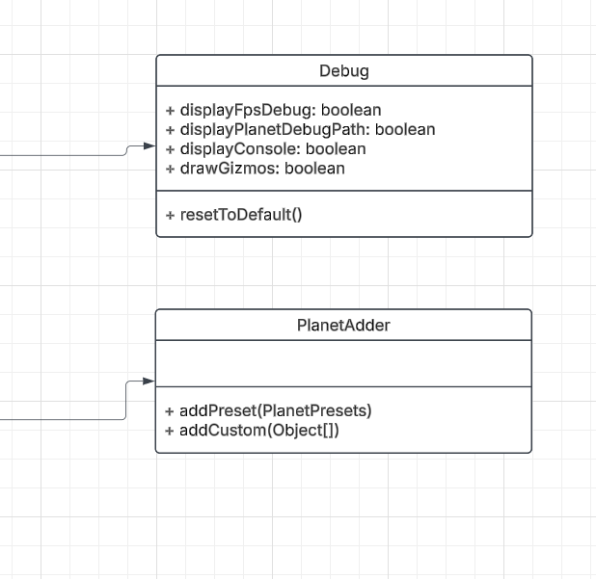
FXML Controllers

Slide 8
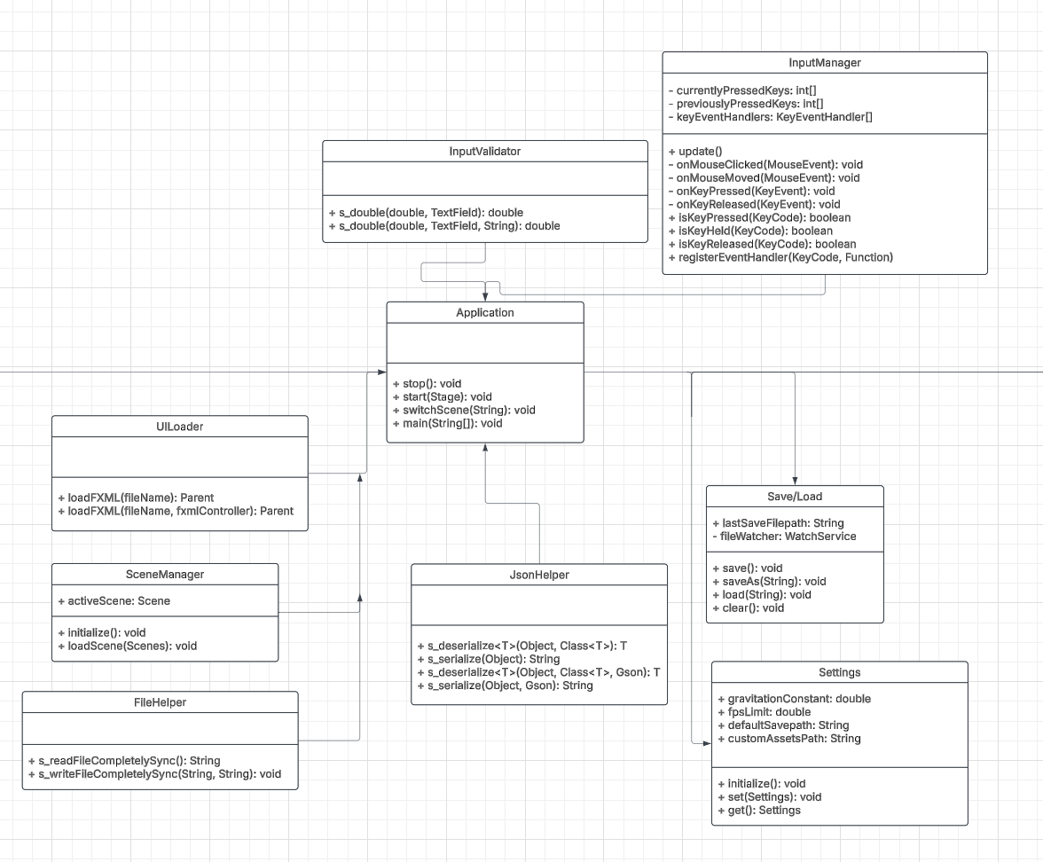
Utilities

Slide 9
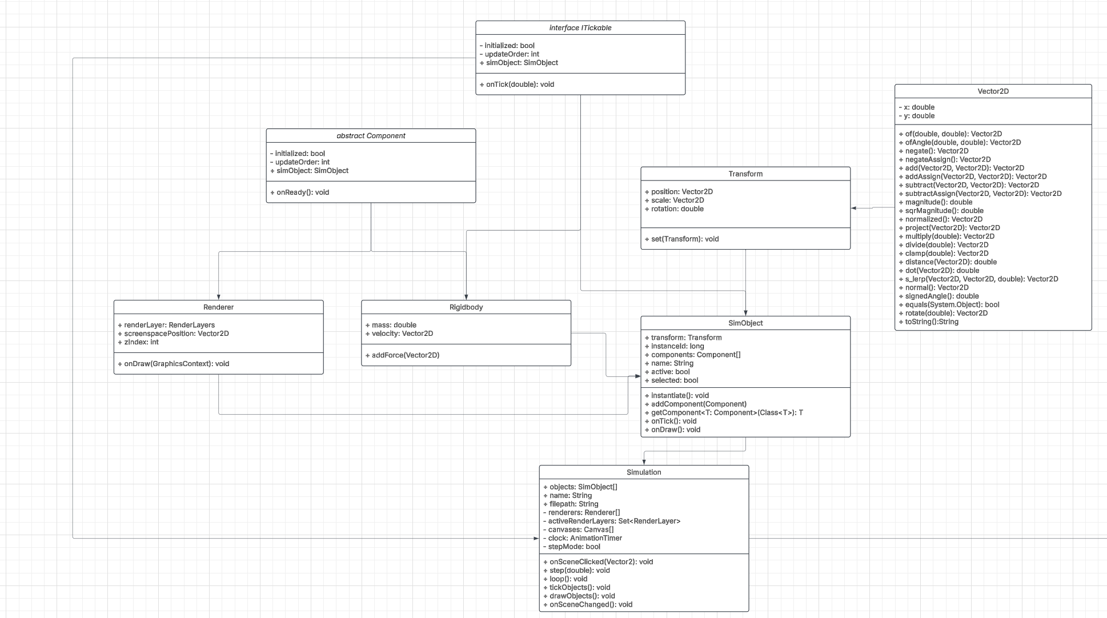
Entity-Component-System

Slide 10
Inputs and Outputs

Slide 11
Inputs
Outputs
Mouse Inputs
Numerical Properties of Each Astral Object
Number Value Inputs
(Keyboard)
Animation of the Space System
Notes:
model part of the mvc to the view part of the mvc

Slide 12
Wireframes

Slide 13
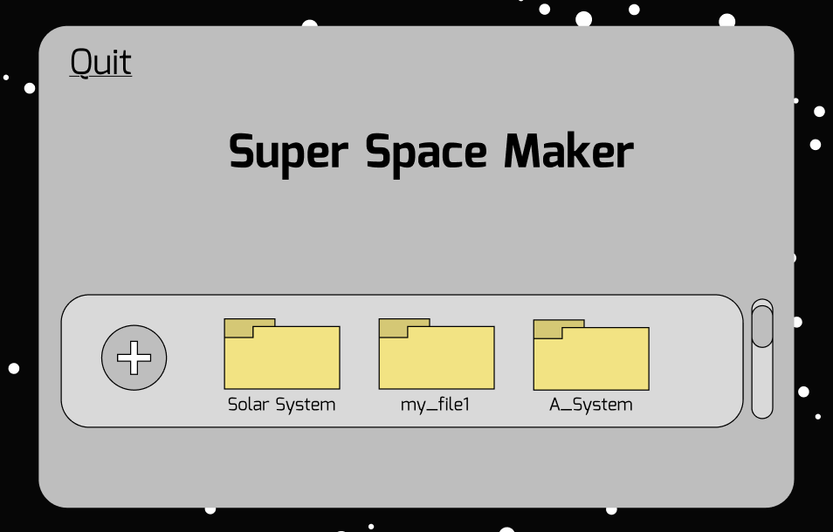
Title Screen

Slide 14
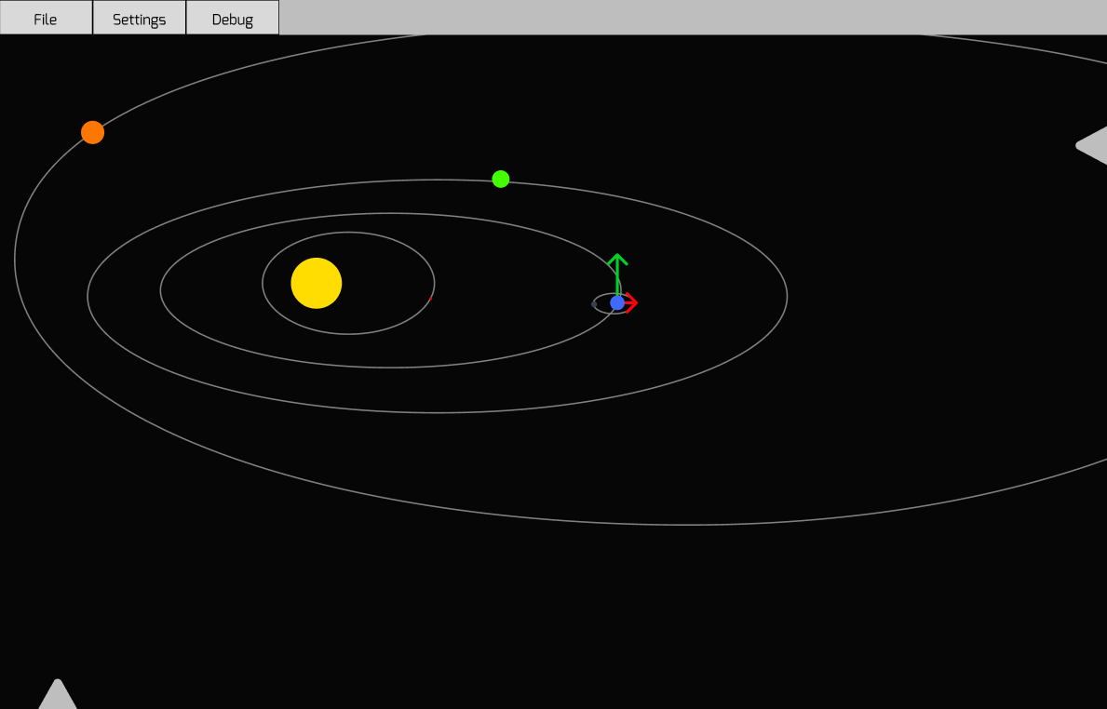
Main Screen

Slide 15
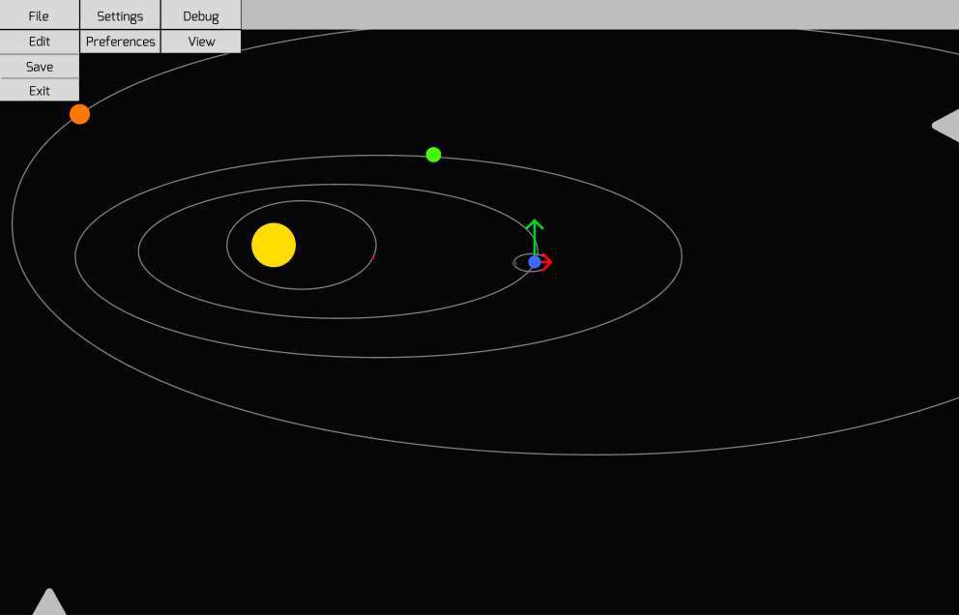
Main Screen

Slide 16
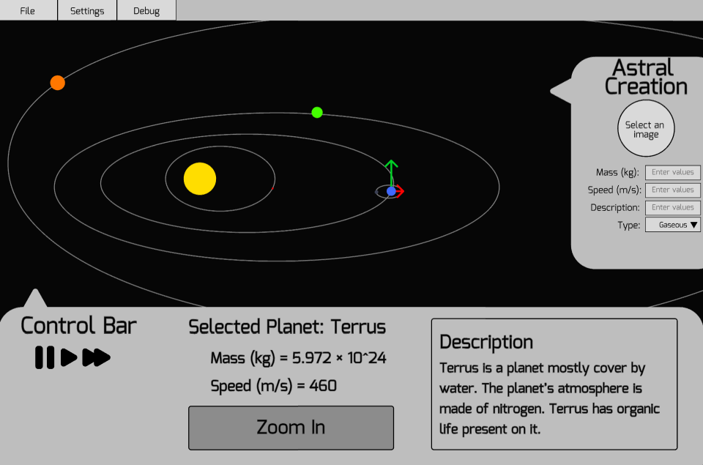
Main Screen

Slide 17
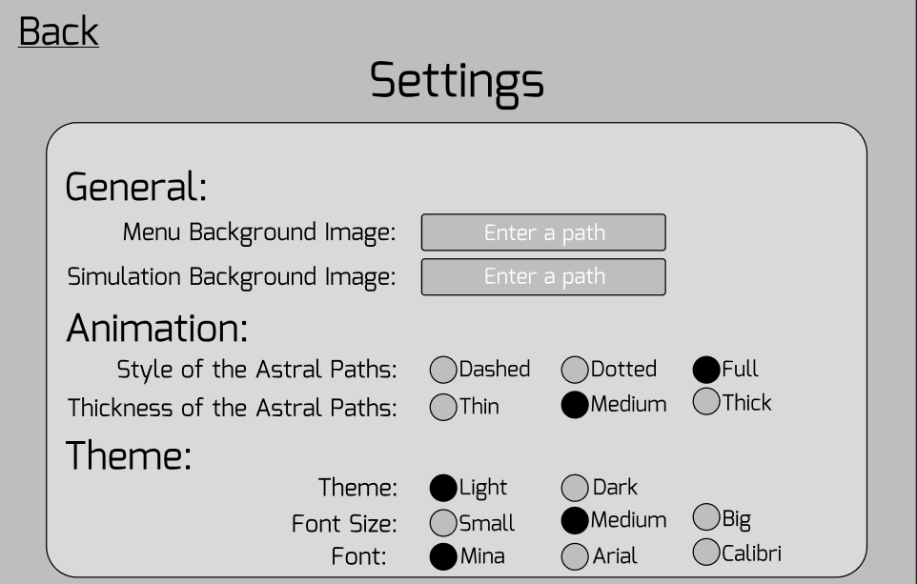
Settings Screen

Slide 18
Stories Progress

Slide 19
Stories the team starts in this sprint:
As a student, I want to be able to customize my own planets so that I can visualize how solar systems work.
As a student, I want to be able to zoom in on planets so that I can see their respective data.
As a student, I want to easily see accurate planetary physics so that I can better understand the physics involved.

Slide 20
Cristian’s Tasks
Received Stories | Resolved Stories | Carry Over Stories | Blocked Stories
As a student, I want to be able to customize my own planets so that I can visualize how solar systems work. (7)
As a student, I want to easily see accurate planetary physics so that I can better understand the physics involved. (5)
As a student, I want to have to option to save my simulations so that I can keep simulations that I like. (5)
As a student, I want to be able to customize the look of my animation so that I can find it more visually aesthetic. (11)
As a student, I want to be able to zoom in on planets so that I can see their respective data.(15)
As a student, I want to be able to change variables so that I can simulate different outcomes. (1)
Total points: 44 | Total points: 0 | Total points: 0 | Total points: 0
: task started this sprint

Slide 21
Adriano’s Tasks
Received Stories | Resolved Stories | Carry Over Stories | Blocked Stories
As a student, I want to be able to customize my own planets so that I can visualize how solar systems work. (8)
As a student, I want to have to option to save my simulations so that I can keep simulations that I like. (4)
As a student, I want to calculate various properties of different spatial bodies so I can better understand the physics involved. (3)
As a student, I want to easily see accurate planetary physics so that I can better understand the physics involved. (12)
As a student, I want to be able to change variables so that I can simulate different outcomes. (1)
As a student, I want to be able to customize the look of my animation so that I can find it more visually aesthetic. (6)
Total points: 34 | Total points: 0 | Total points: 0 | Total points: 0
: task started this sprint

Slide 22
Andrei’s Tasks
Received Stories | Resolved Stories | Carry Over Stories | Blocked Stories
As a student, I want to be able to customize my own planets so that I can visualize how solar systems work. (20)
As a student, I want to calculate various properties of different spatial bodies so I can better understand the physics involved. (15)
As a student, I want to easily see accurate planetary physics so that I can better understand the physics involved. (6)
As a student, I want to have to option to save my simulations so that I can keep simulations that I like. (1)
As a student, I want to be able to zoom in on planets so that I can see their respective data. (1)
Total points: 43 | Total points: 0 | Total points: 0 | Total points: 0
: task started this sprint

Slide 23
Eric’s Tasks
Received Stories | Resolved Stories | Carry Over Stories | Blocked Stories
As a student, I want to be able to customize my own planets so that I can visualize how solar systems work. (8)
As a student, I want to calculate various properties of different spatial bodies so I can better understand the physics involved. (18)
As a student, I want to have to option to save my simulations so that I can keep simulations that I like. (8)
As a student, I want to be able to customize the look of my animation so that I can find it more visually aesthetic. (8)
As a student, I want to be able to change the time frame of the animation so that I can see the evolution of my system over long periods of time. (2)
As a student, I want to be able to change variables so that I can simulate different outcomes. (1)
As a student, I want to easily see accurate planetary physics so that I can better understand the physics involved. (3)
Total points: 48 | Total points: 0 | Total Points: 0 | Total points: 0
: task started this sprint

Slide 24
Work Cited
“10 Free Space Background Images (JPG).” Unblast, 2021, https://unblast.com/10-free-space-background-images-jpg/. Accessed 14 Feb. 2025.

